Slide 1

Cognitive Services
Presentation to ML Workshop
September 2018

Slide 2


Intelligence Explosion
Today 2020 2040 ….
Notes:
530 million years ago evolution unlocked the power to see and intelligent life exploded on the planet.
Unfortunately you and I weren’t there to enjoy it.
Today, you saw how unlocking AI is seeding the intelligence explosion that will change our future world.
This is your time and you get to shape it.
I invite all of you to BUILD the future.

Slide 3

“
OUR GOAL IS TO DEMOCRATIZE A.I.
TO EMPOWER EVERY PERSON
AND EVERY ORGANIZATION
TO ACHIEVE MORE
”
SATYA NADELLA
Notes:
Despite the rapid growth in information, there's still one thing that remains constant:
Time - we are still constrained by our human capacity to absorb it.
So, how can we use all we have in terms of computational power to make better sense of the world in the time we have?
That's the essence of what AI is,“
That is why our goal is to democratize AI - to help people achieve more
“Technology is reshaping society as we know it.”
Key points to land
Technology is reshaping society
Timeless values must endure
It’s about augmenting, not replacing, the human experience

Slide 4
Microsoft AI
For every person and every organization
Agent
Applications
Services
Infrastructure

Slide 5
Services
Cortana Intelligence
Cognitive Services
Bot Framework
Cortana Devices SDK
Cortana Skills Kit SDK
Cognitive Toolkit
Notes:
So let me tell you more about our AI developer tools. We are so fortunate to have a 25 years of investment in Research, and our goal is to make the AI advances we use in our products, available to all developers.

Slide 6
Are you a Lazy Developer?
NO, it’s all about efficiency

Slide 7

Azure Cognitive Services
Vision
Language
Speech
Search
Knowledge
Computer vision
Face
Emotion
Content Moderator
Video
Text analytics
Spell check
Web language model
Linguistic analysis
Translator
Speaker recognition
Speech
Web search
Image search
Video search
News search
Autosuggest
Academic knowledge
Entity linking service
Knowledge exploration
Recommendations
QnA maker
NEW Video Indexer
NEW Cognitive Services Labs
NEW
NEW
NEW
Custom
Custom
Custom
Custom
Custom
Vision Service
Language Understanding
Speech Service
Search
Decision Service
Notes:
Key messages
Cognitive Services bringing AI to every developer and every scenario.
It helps integrate Vision, Language, Speech, Search and Knowledge into applications.
This is the richest set of AI services for developers in the industry. 31 services covering every scenario you can think of.
It is incredibly easy to build amazingly powerful AI apps combining cognitive services with other Azure capabilities.

Slide 8
Bing image search
Speech API
Entity linking
Customer feedback analysis
Bing news search
Speech
Text to speech
Custom recognition (CRIS)
Forecasting
Language
Recommendation API
Machine Learning
Text analytics
Thumbnail generation
Cognitive Services APIs
Academic knowledge
Spell check
Web language model
Knowledge
Bing autosuggest
Computer vision
Vision
Emotion
Anomaly detection
Sentiment scoring
Search
OCR, tagging, captioning
Bing web search
Notes:
Similar to the structure we have for our advanced bots like Cortana, Xioaice and Zo, an advanced app or bot, needs to be organized into parts, much like a “brain” with state, memory, and the ability to dispatch to different parts.
Each of these brain parts can provide different functionality or use different techniques. For example, let’s talk about building a business bot. Part of your bot might show: guided fix dialog, buttons and cards, filling out a form, or querying a database.
A very common starting point for companies wanting to build bots is to help customers answer their questions. Today this is really a crummy experience for customers. Often you go to the website, look for online help, and read through a long document to find your question and the answers….hopefully it’s there.
On the business end, this also is a crummy experience for companies, who typically have a writer who spent time writing a FAQ based on what that person thinks will be asked most, but these documents are often outdated, incomplete, and don’t always reflect the questions customers actually ask.
This is a simple place where bots improve the user experience for customers and companies.
Today we are releasing a new Cognitive Service, QnA Maker, which lets you easily create a bot to improve this user experience.
This is just one of 25 different intelligent services we offer with Microsoft Cognitive Services.

Slide 9
AI in Real Life
Notes:
Similar to the structure we have for our advanced bots like Cortana, Xioaice and Zo, an advanced app or bot, needs to be organized into parts, much like a “brain” with state, memory, and the ability to dispatch to different parts.
Each of these brain parts can provide different functionality or use different techniques. For example, let’s talk about building a business bot. Part of your bot might show: guided fix dialog, buttons and cards, filling out a form, or querying a database.
A very common starting point for companies wanting to build bots is to help customers answer their questions. Today this is really a crummy experience for customers. Often you go to the website, look for online help, and read through a long document to find your question and the answers….hopefully it’s there.
On the business end, this also is a crummy experience for companies, who typically have a writer who spent time writing a FAQ based on what that person thinks will be asked most, but these documents are often outdated, incomplete, and don’t always reflect the questions customers actually ask.
This is a simple place where bots improve the user experience for customers and companies.
Today we are releasing a new Cognitive Service, QnA Maker, which lets you easily create a bot to improve this user experience.
This is just one of 25 different intelligent services we offer with Microsoft Cognitive Services.

Slide 10
Custom Vision
Image Classification & Image Identification
Zero Coding
Support for Mobile Platforms (iOS, Android)
REST Interface and SDKs for developers
Use Portal: customvision.ai
Use Python SDK to predict the image class

Slide 11
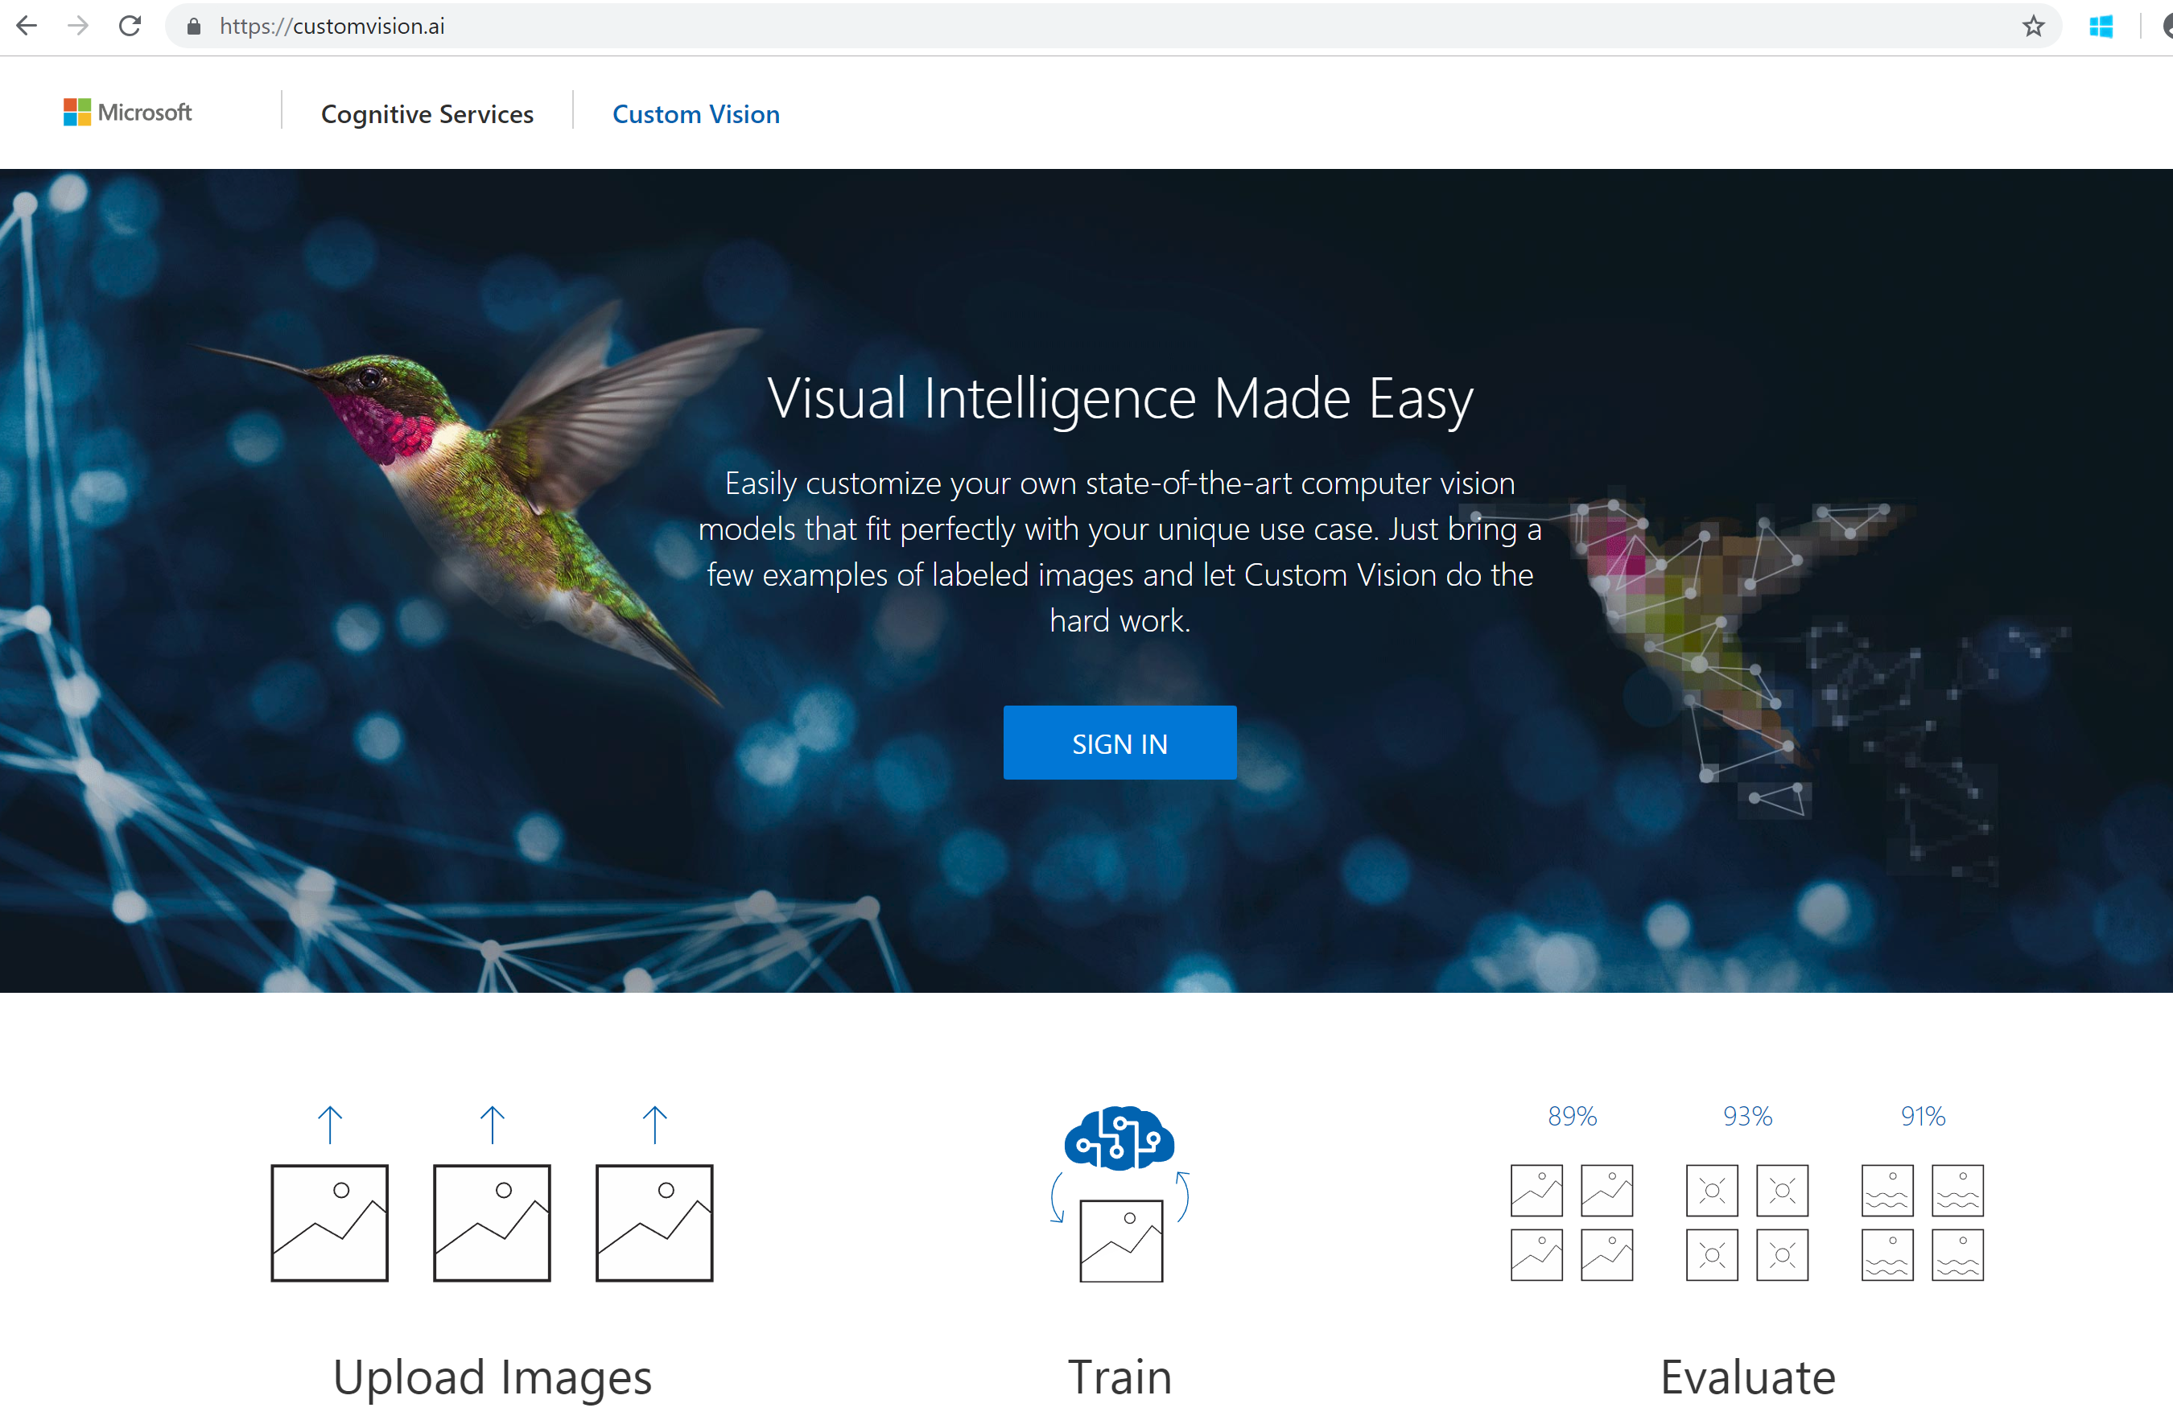
customvision.ai

Slide 12
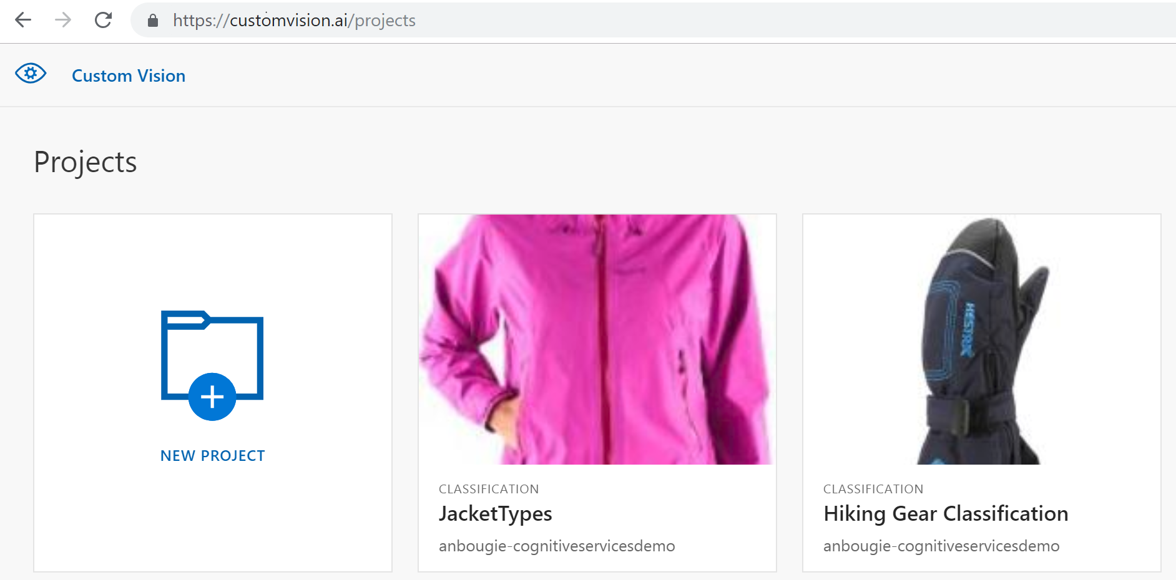
customvision.ai: Create a Project

Slide 13
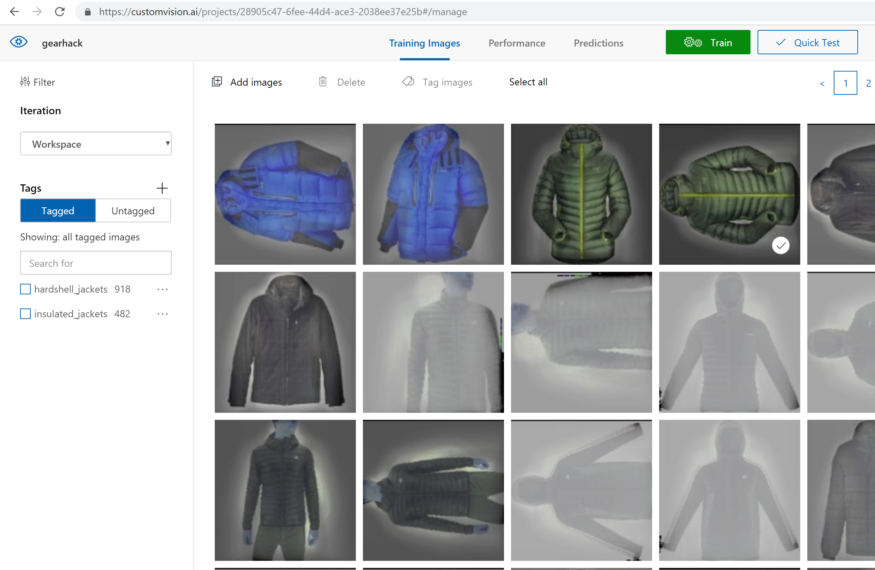
customvision.ai: Upload & Tag Images

Slide 14
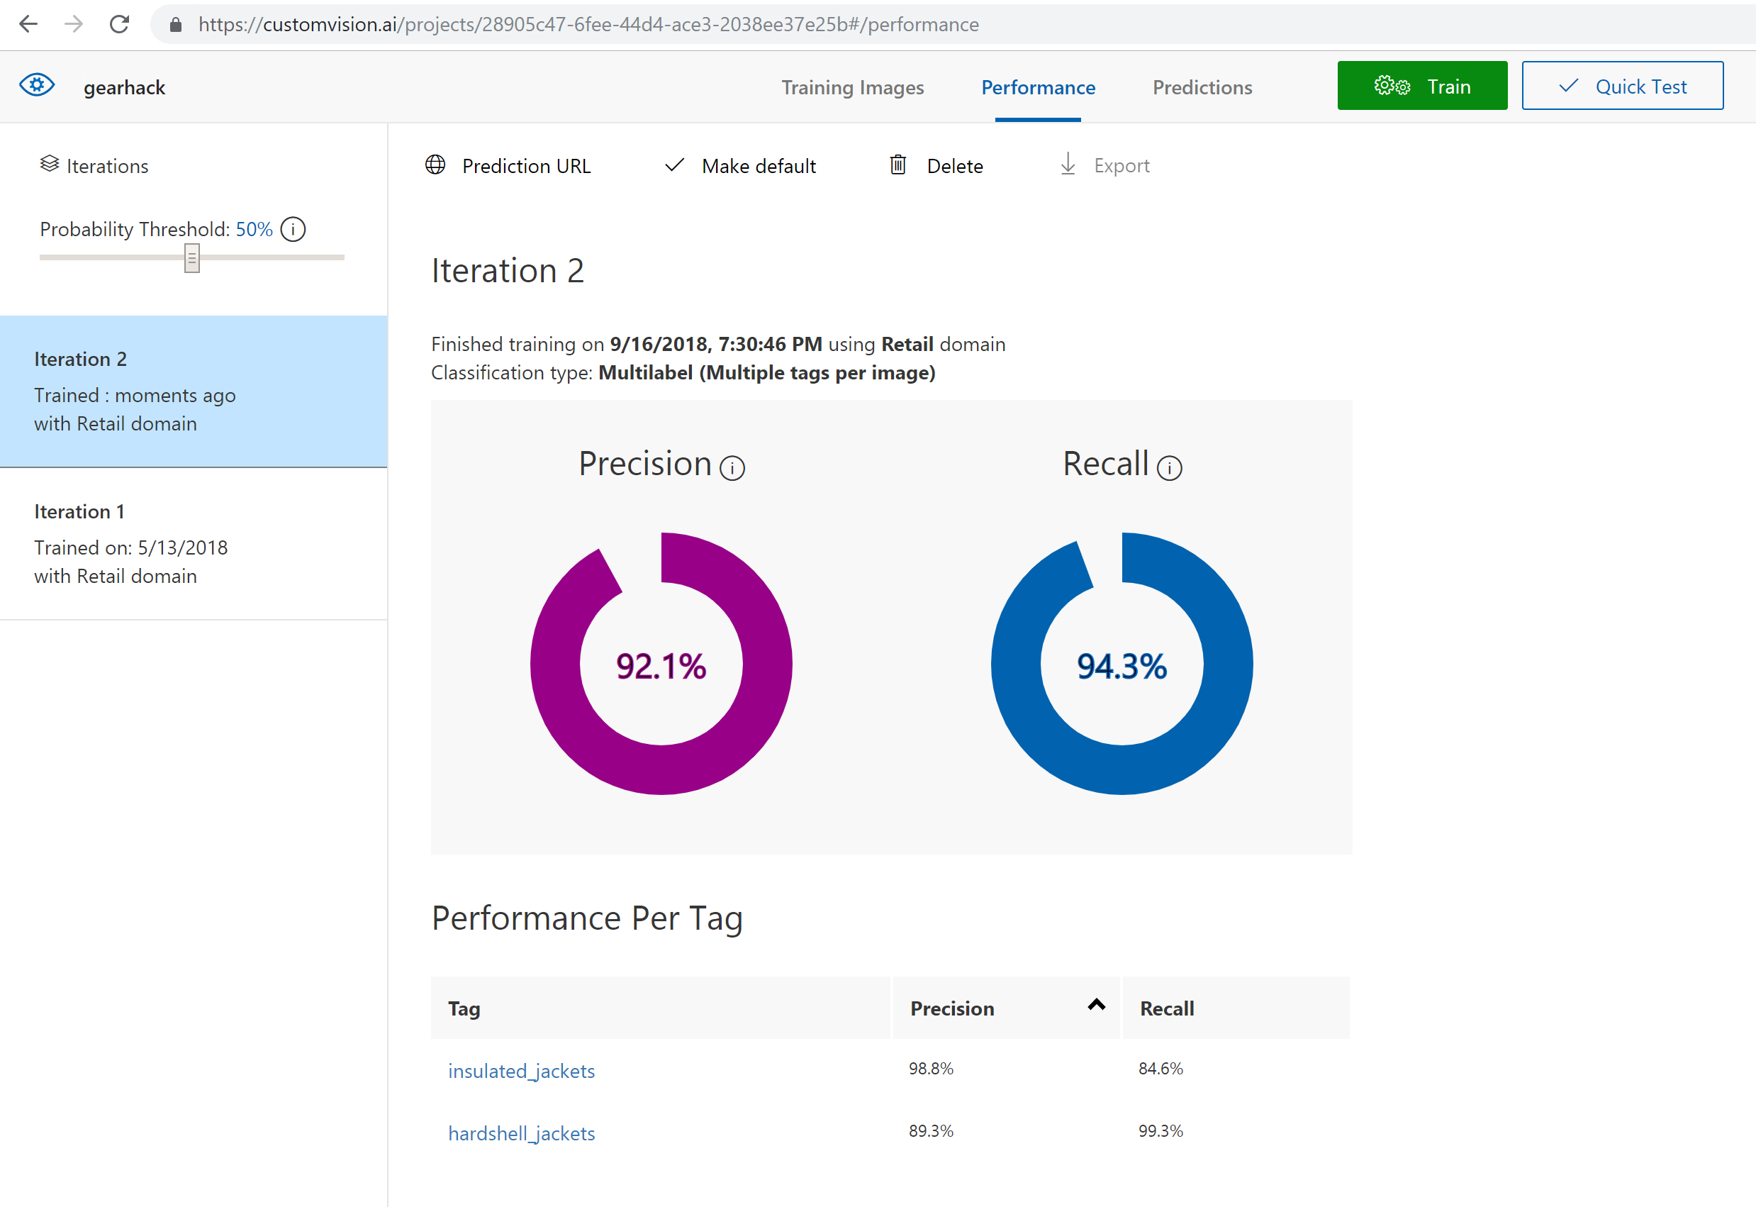
customvision.ai: Train the Model

Slide 15
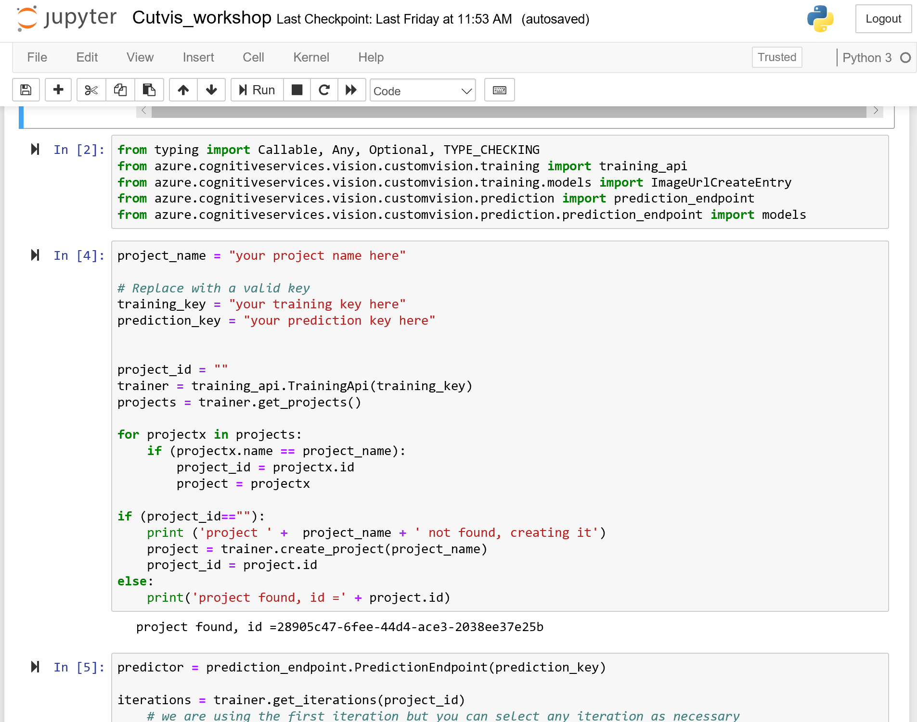
Predict with Python SDK

